Slide 1


Social Buzz

Slide 2


Today's agenda
Project recap
Problem
The Analytics team
Process
Insights
Summary

Slide 3

The “Social Buzz” is the social media & content creation platform established in the year 2010 with around 250 employees.
Expectations of Social Buzz from external expertise:
Audit of big data practice.
Analysis of popular contents.
Recommendations for IPO.
Project Recap

Slide 4


Problem
The client “Social Buzz” face a drastic increase in generation of data which impacts in problem of managing data due to the lack of resources to deal with big data.

Slide 5




ANDREW FLEMING
Chief Technology Architect
The Analytics team
MARCUS ROMPTON
Senior Principal
[Myself]
Data Analyst

Slide 6
Process
1
Requirements Gathering
2
Data Cleaning
3
Data Modelling
4
Data Viz
5
Data Analysis & Storytelling

Slide 7

Insights
16
1897
JANUARY
UNIQUE
CATEGORIES
REACTIONS TO "ANIMAL" POSTS
MONTH WITH
MOST POSTS

Slide 8

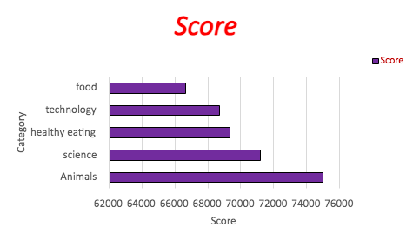

Slide 9
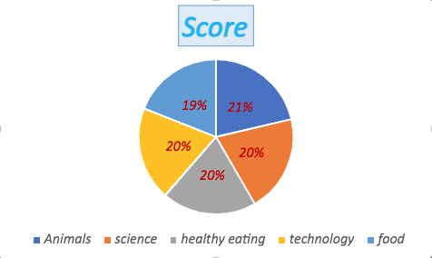

Slide 10


The top 5 categories are:
Animals
science
healthy eating
Technology
food
ANALYSIS
Summary
Animals and science are the two most popular categories of content, showing that people enjoy "real-life" and "factual" content the most.
INSIGHT
Food is a common theme with the top 5 categories with "Healthy Eating" ranking the highest. This may give an indication to the audience within your user base. You could use this insight to create a campaign and work with healthy eating brands to boost user engagement.

Slide 11

Thank you!
ANY QUESTIONS?

